Slide 1
Use of Different Machine Learning Techniques to Predict Risk of Stroke
MACHINE LEARNING [D]
Supervised by
Prof. Dr. Md. Asraf Ali
American International University- Bangladesh
Group information:
NAME | ID
SHOWMITRA ROY | 20-44208-3
ASIF AHMED TANJID | 20-44249-3
SUNJIDA KABIR SHEPA | 20-44263-3
MD. RAHANUR NISHAN | 20-43093-1
SUBMISSION DATE: 14/05/2023

Slide 2


Table of Contents
Objectives
Problem statement
Methodology
Dataset description
Data pre-processing
Machine learning models
Results
Literature review
Conclusion
references

Slide 3
OBJECTIVES
Stroke is a severe medical condition that results from the sudden stoppage of blood flow to a part of the brain.
Early detection of stroke risk is necessary to prevent disability and promote a healthy lifestyle.
Machine learning models can be used to evaluate and predict the risk of stroke.

Slide 4
objectives
A dataset with relevant features is preprocessed to make it suitable for the experiment.
Various machine learning models such as Naive Bayes, Decision Tree, Logistic Regression, K-Nearest Neighbors, and Support Vector Machine are applied to the dataset to predict the risk of stroke.
The accuracy of the models is calculated, and the results show that SVM and LR have a 96.05% accuracy for 6 features, while the other models vary from 87% to 95%.
The accuracy for all features is over 90% for all the models and 96.05% for SVM, LR, and NB, which is an improved accuracy compared to previous works on the same dataset.

Slide 5
Problem statement
Stroke is a leading cause of death and disability worldwide, and it is imperative to identify individuals who are at high risk of developing a stroke. However, accurately predicting the risk of stroke in an individual is a challenging task that requires complex analysis of various risk factors.
To address this issue, different machine learning techniques have been applied to predict the risk of stroke. However, the effectiveness of these techniques varies, and there is a need to evaluate and compare their performance to identify the most accurate and reliable approach.

Slide 6
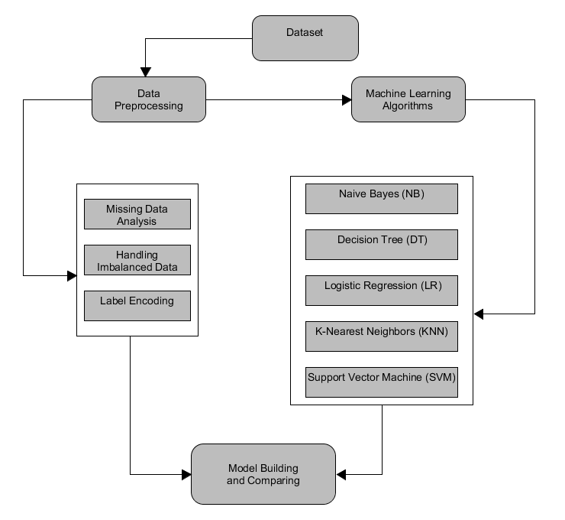
methodology
For our research, a basic approach was used to conduct the research.
Block Diagram:

Slide 7
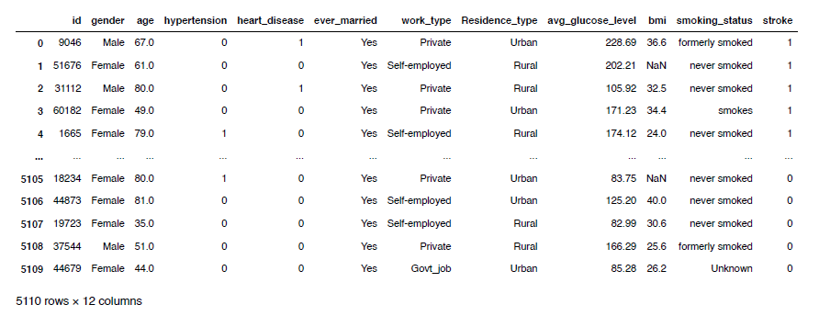
Dataset description
Dataset link : https://www.kaggle.com/datasets/fedesoriano/stroke-prediction-dataset?resource=download

Slide 8
Dataset description
Dataset acquired from Kaggle, titled "Stroke Prediction Dataset"
Dataset contains 12 features/attributes and 5110 participants
Features include gender, age, hypertension, heart disease, marital status, work type, residence type, average glucose level, BMI, smoking status, and stroke status
Most features are nominal, while age, average glucose level, and BMI are numerical
Pre-trained models were used, so the dataset was only used for testing accuracy

Slide 9
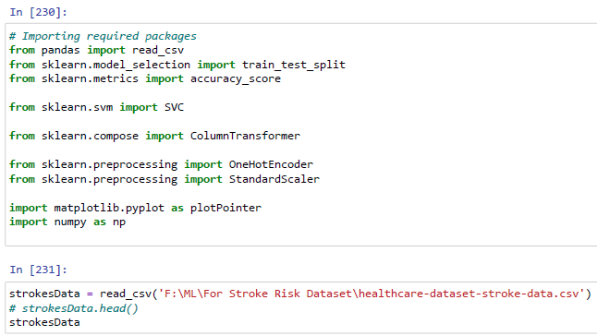

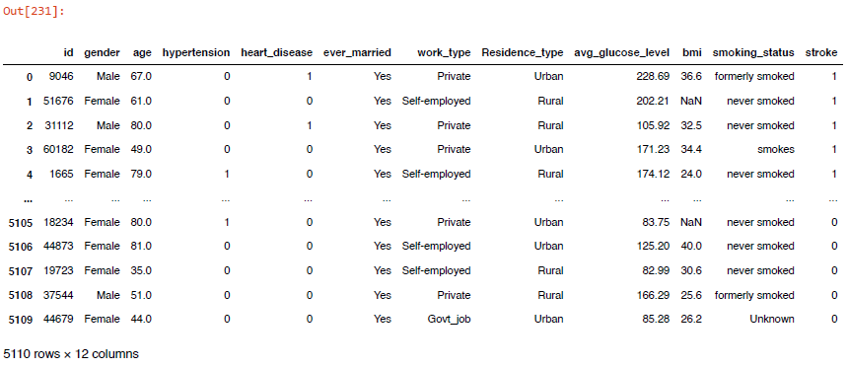
Data pre-processing
First import all necessary modules, and settings.

Slide 10

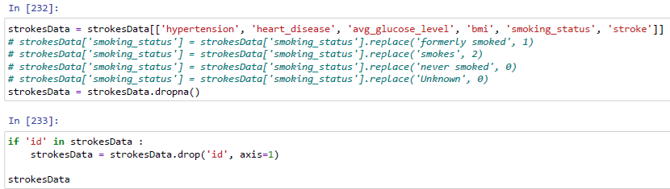
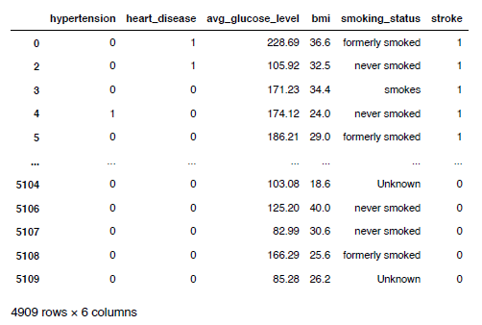
Data pre-processing
After applying this Dropna function to remove id feature

Slide 11
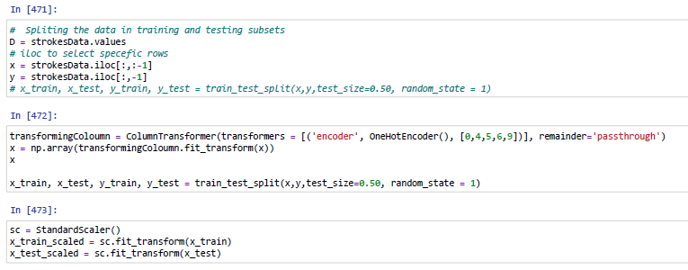
Data pre-processing
Algorithm to scale non-numeric value.

Slide 12
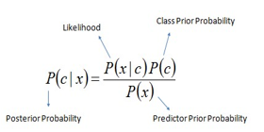
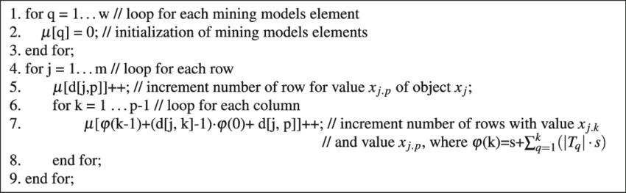
Machine learning models
Naive Bayes: The naive Bayes (NB) classifier was considered, which ensures probability maximization if the features are highly independent. The equation for Naive Bayes is the following:
Binary and multi-class classification can both be done using the Naive Bayes technique.

Slide 13
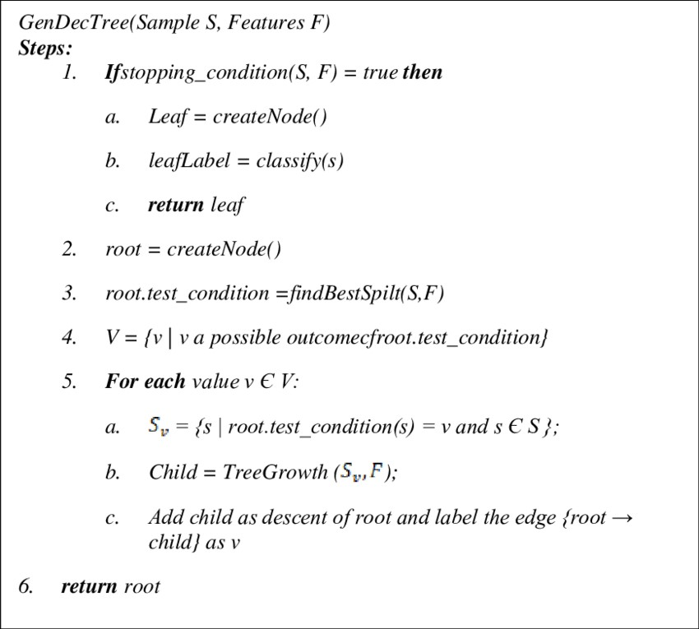
Machine learning models
Decision Tree: For the development of a decision tree, we considered J48 as a single classifier and RepTree as a base classifier in the stacking method. A DT’s leaf nodes indicate the classes, while its inside nodes stand in for a feature.

Slide 14
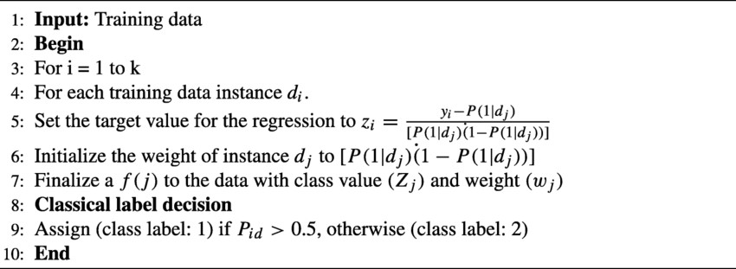
Machine learning models
Logistic Regression: Logistic regression is a statistical classification method originally developed for binary tasks but extended to multiclass tasks.

Slide 15
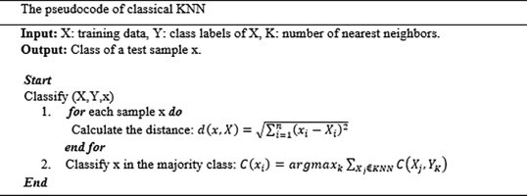
Machine learning models
K-Nearest Neighbors: The K-Nearest Neighbor (K-NN) classifier is a distance-based method for calculating the similarity or difference between two instances in the dataset being studied.

Slide 16
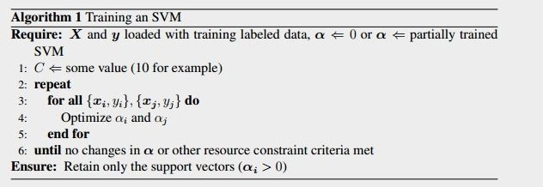
Machine learning models
Support Vector Machine: Support Vector Machine (SVM) is a supervised machine learning algorithm used for both classification and regression.

Slide 17
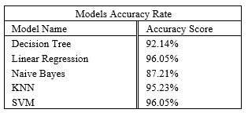
Results
Accuracy rate for different models:
The highest accuracy from the different models is 96.05% for the Support Vector Machine. The same accuracy (96.05%) was for Linear Regression. The least accurate for predicting stroke is 87.21% for Naive Bayes. The KNN model gave 95.23% accuracy which is near the highest accuracy. The accuracy of the Decision Tree is 92.14%.

Slide 18
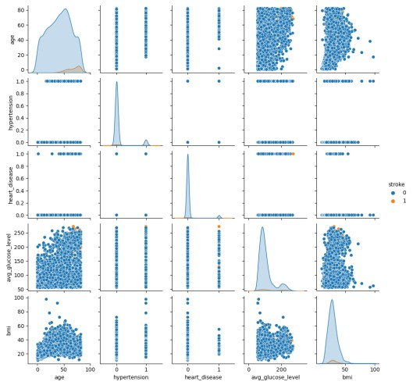
Results
Figure shows the comparison between the stroke and the other features. From THIS figure At the age of 40 to 80 the possibility of stroke is higher
Moreover, the average glucose level gradually increased at this age. Having hypertension makes the high possibility of stroke. Heart disease also causes a stroke. Also, BMI gets higher at the age of 50 and it causes serious damage to the body.

Slide 19
Literature Review
Description: | Citations:
Firstly, the authors of the paper [3] have used eight different machine learning algorithms such as Naive Bayes (NB), Random Forest (RF), Logistic Regression (LR), K-Nearest Neighbors (KNN), Stochastic Gradient Descent (SGD), Decision Tree (DT), Multilayer Perceptron (MLP), Majority Voting, and Stacking in order to accurately detect a stroke. For their research, the authors used the dataset [4] from Kaggle which contained information regarding the 11 key features of stroke from 3254 participants. The accuracy of the Naive Bayes was 84%, Random Forest was 79%, Logistic Regression was 81%, K-Nearest Neighbors was 88%, Stochastic Gradient Descent was 91%, Decision Tree was 92%, Multilayer Perceptron was 93%, Majority Voting was 97%, and Stacking was 98%. Stacking had the highest accuracy of 98% in stroke detection in their research paper. | [3] Dritsas, E. and Trigka, M., “Stroke risk prediction with machine learning techniques,” Sensors, vol. 22, no. 13, p. 4670, 2022.

Slide 20
conclusion
A stroke constitutes a threat to a human’s life that should be prevented and/or treated to avoid unexpected complications. Nowadays, with the rapid evolution of AI/ML, clinical providers, medical experts and decision-makers can exploit the established models to discover the most relevant features (or, else, risk factors) for stroke occurrence, and can assess the respective probability or risk.

Slide 21
References
[1]“Aboutstroke,”Nov2022.[Online].Available: https://www.cdc.gov/stroke/about.htm?fbclid=IwAR2VDRTwIDLOECyPkzoTOsvzJrl8UDfGvFmjC6Zaa12MAyOrrg0zEjLyw#:„:text=A%20stroke%2C%20sometimes%20called%20a, term%20disability%2C%20or%20even%20death
[2] Tazin, T., Alam, M. N., Dola, N. N., Bari, M. S., Bourouis, S., and Monirujjaman Khan, M., “Stroke disease detection and prediction using robust learning approaches,” Nov 2021. [Online]. Available:https://www.hindawi.com/journals/jhe/2021/7633381/?fbclid=IwAR3XpfsouLk4D-Bnbx94mK6DG9VvRau9DZ3NRfZx3ZUkJ7kV6sggbY7iekw
[3] Dritsas, E. and Trigka, M., “Stroke risk prediction with machine learning techniques,” Sensors, vol. 22, no. 13, p. 4670, 2022.
[4] Hung, C.-Y., Chen, W.-C., Lai, P.-T., Lin, C.-H., and Lee, C.-C., “Comparing deep neural network and other machine learning algorithms for stroke prediction in a large-scale population-based electronic medical claims database,” in 2017 39th Annual International Conference of the IEEE Engineering in Medicine and Biology Society (EMBC). IEEE, 2017, pp. 3110–3113.
[5] Fedesoriano, “Stroke prediction dataset,” Jan 2021. [Online]. Available:
https://www.kaggle.com/datasets/fedesoriano/stroke-prediction-dataset

Slide 22

Thank You

